Slide 1
Git Hub
Assignment 5
Presented by :-
Himanshu Singh
Guided by :-
Ashish Sir

Slide 2
About Git :-
Global information tracker.
it is DVCS.
Devlpoment of GIT:-linus torvalds in 2005.
Before git linux uses bit keepar foe vcs.
bit keepar was third pary software.
Git is the software or tool.
Github is different from git.
Git is a tool for us who can manage versioning.

Slide 3
About (VCS) version control system
there are three types of version control system:-
LVCS :- local version control system.
CVCS :- centrallized version control system.
DVCS :- distributed version control system.

Slide 4
Difference in CVCS and DVCS:-
CVCS :-
In this type of vcs we do not have local repo(only remote repo).
Slow
Easy to understand.
If your remote server fails, you can't do your work.
DVCS :-
We have local as well as remote repo.
Fast
Hard to understand.
We have local copy-hence we can do our work even if remote server is failed.

Slide 5
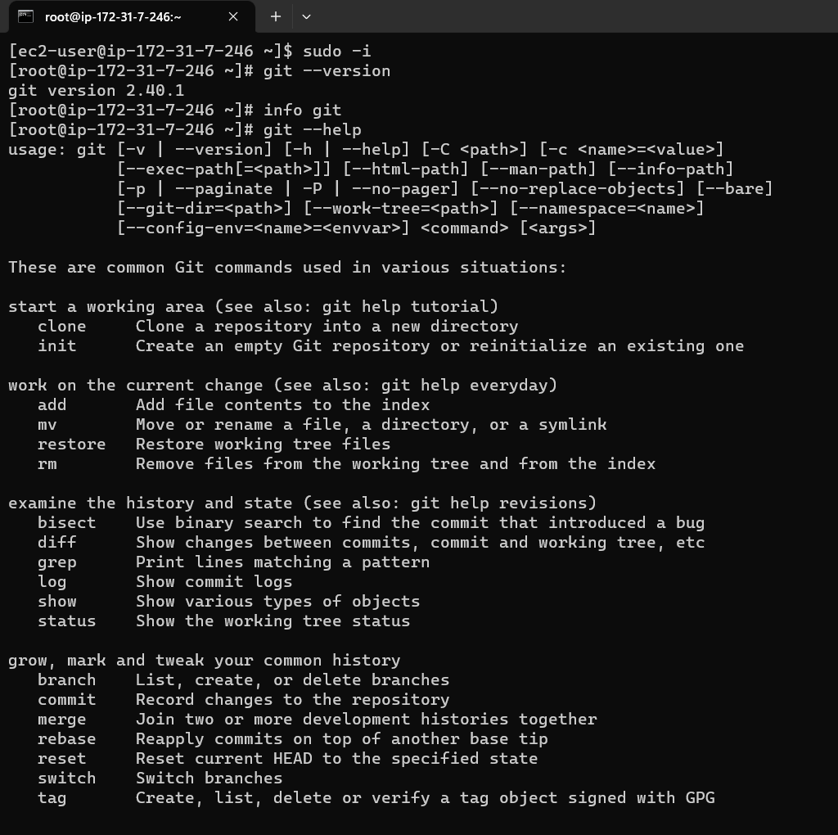
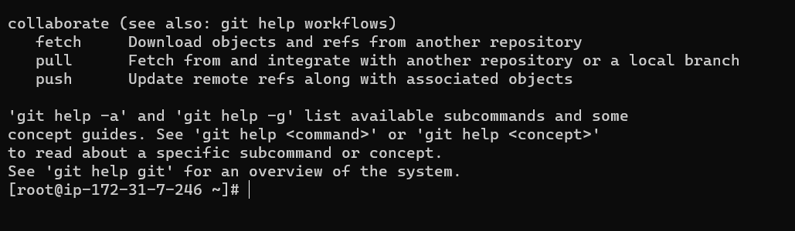
Important Commands

Slide 6
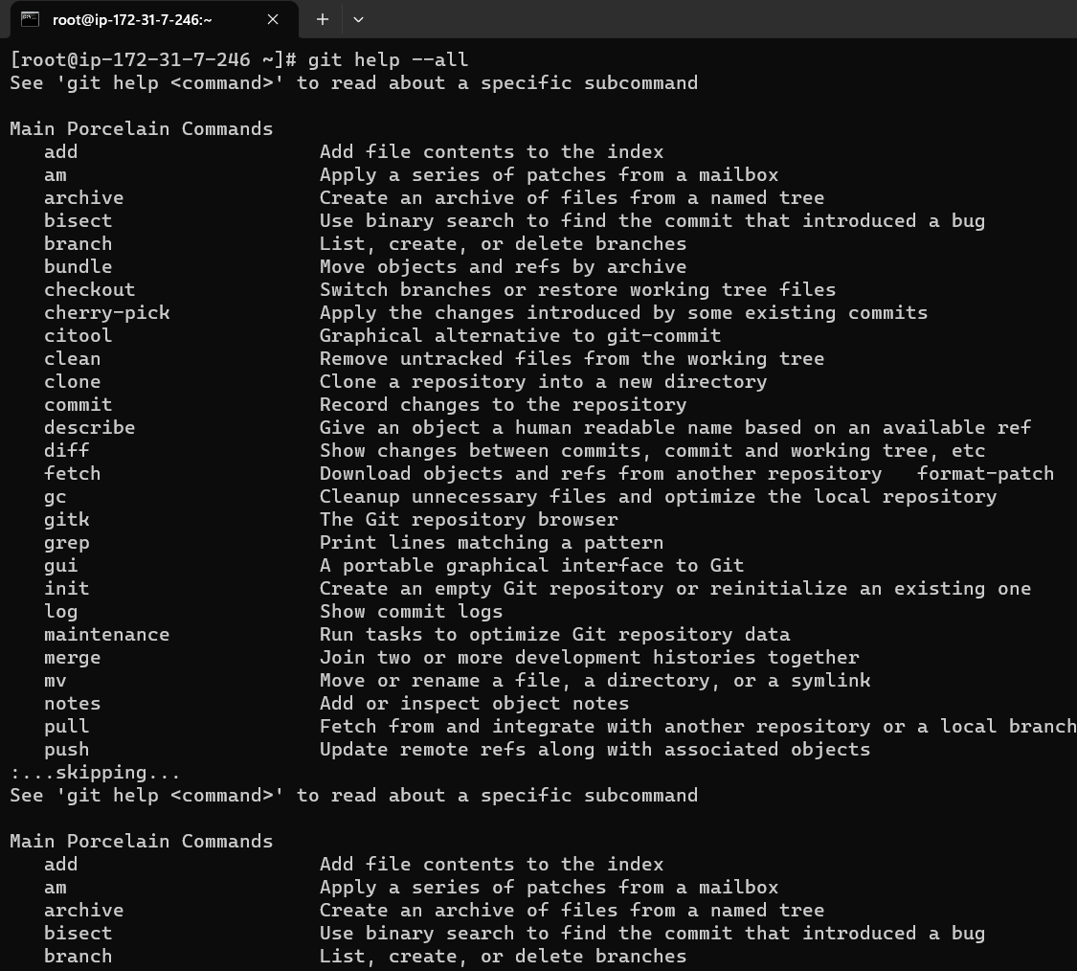
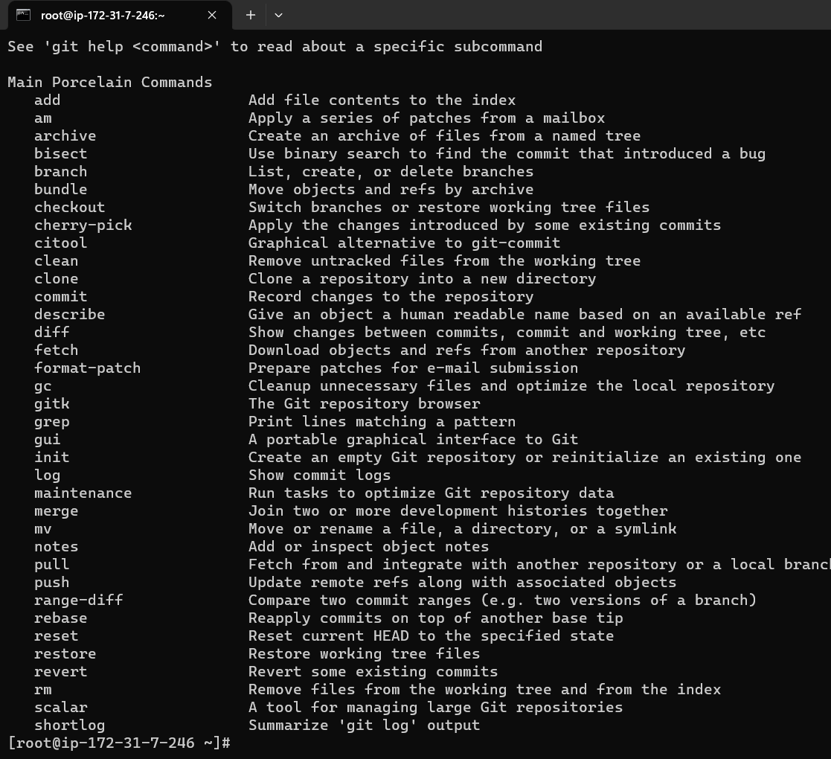

Slide 7
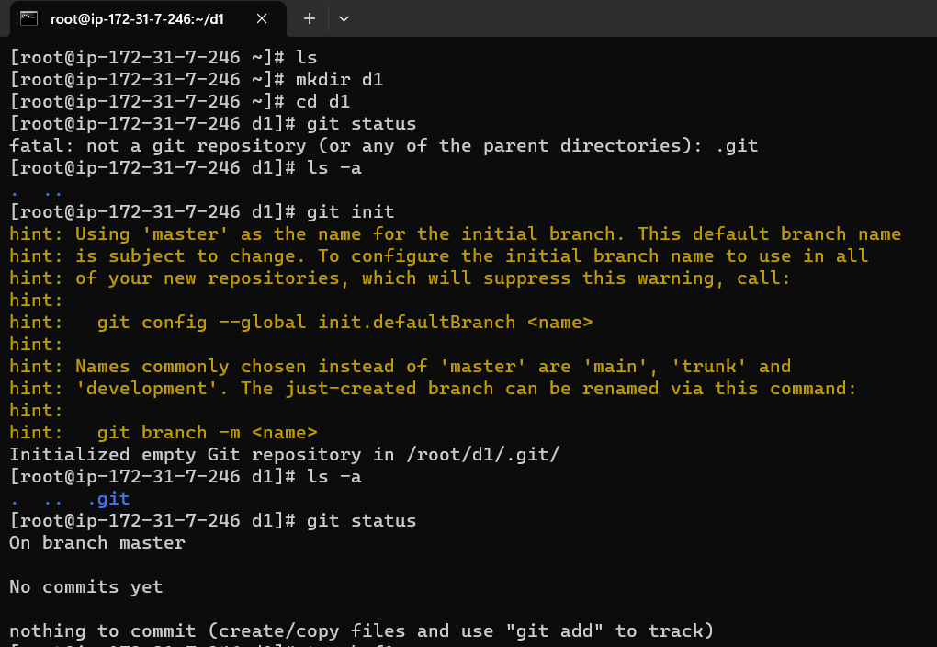
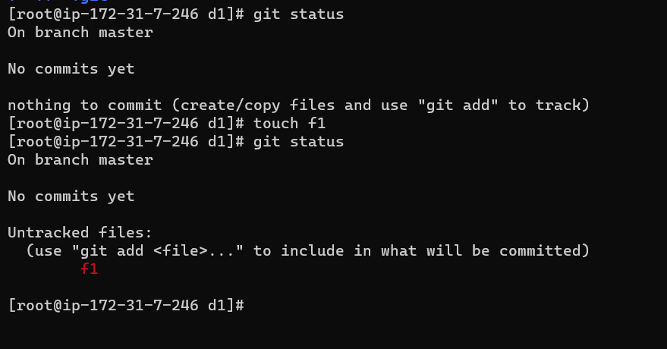

Slide 8
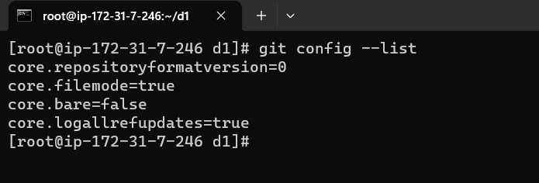
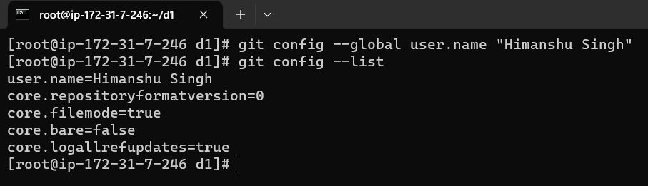
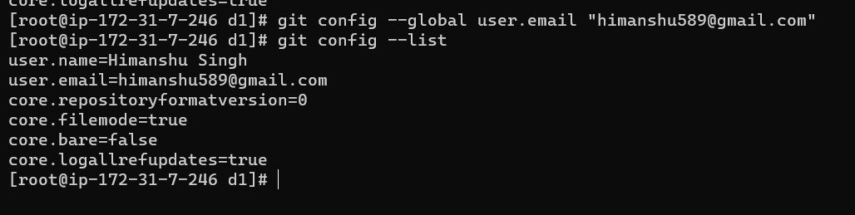
Git Config :-

Slide 9
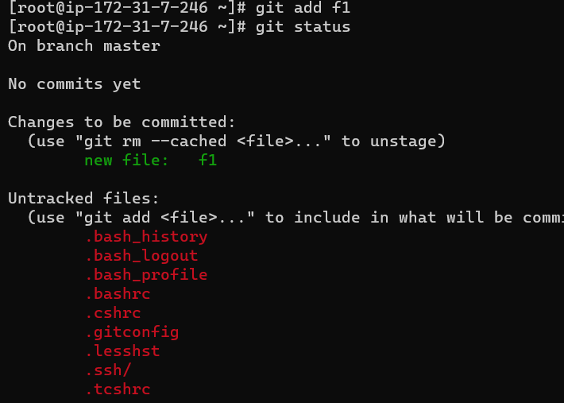
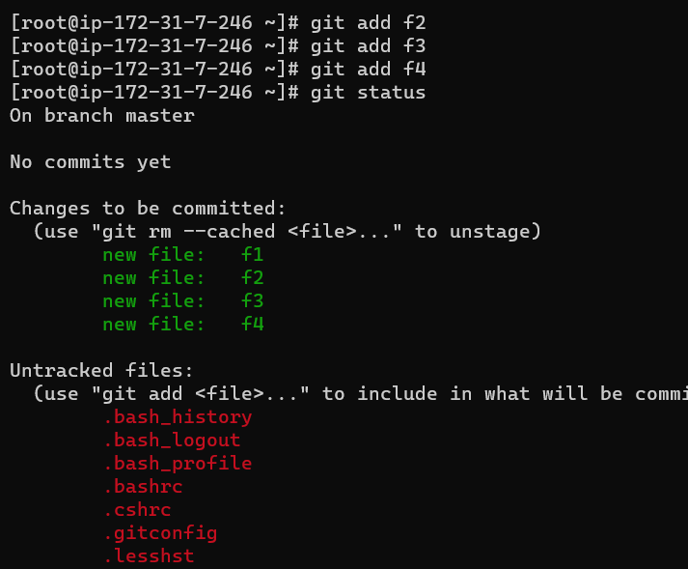
Commiting and Untracked File :-

Slide 10
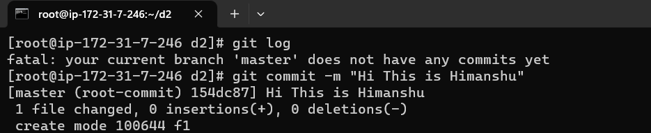
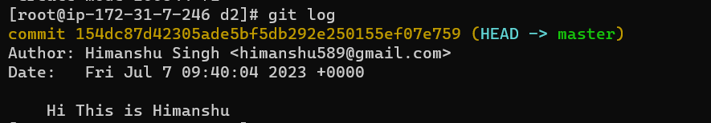
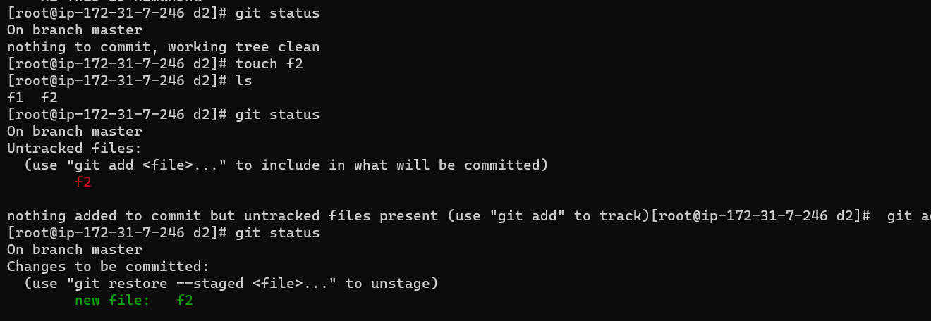
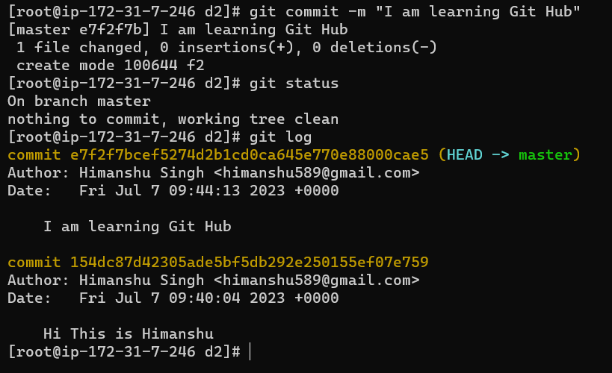
Commiting The Massage :-

Slide 11
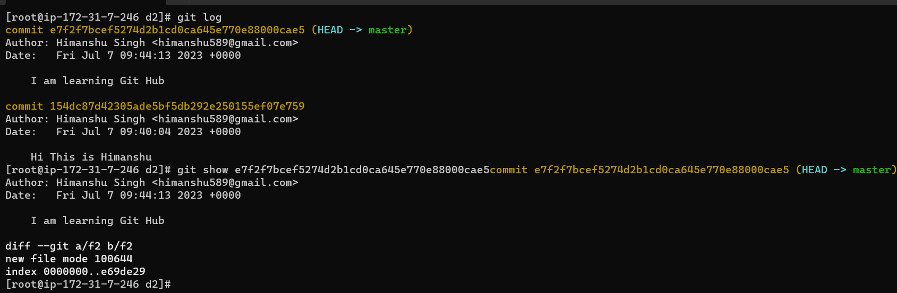

Slide 12
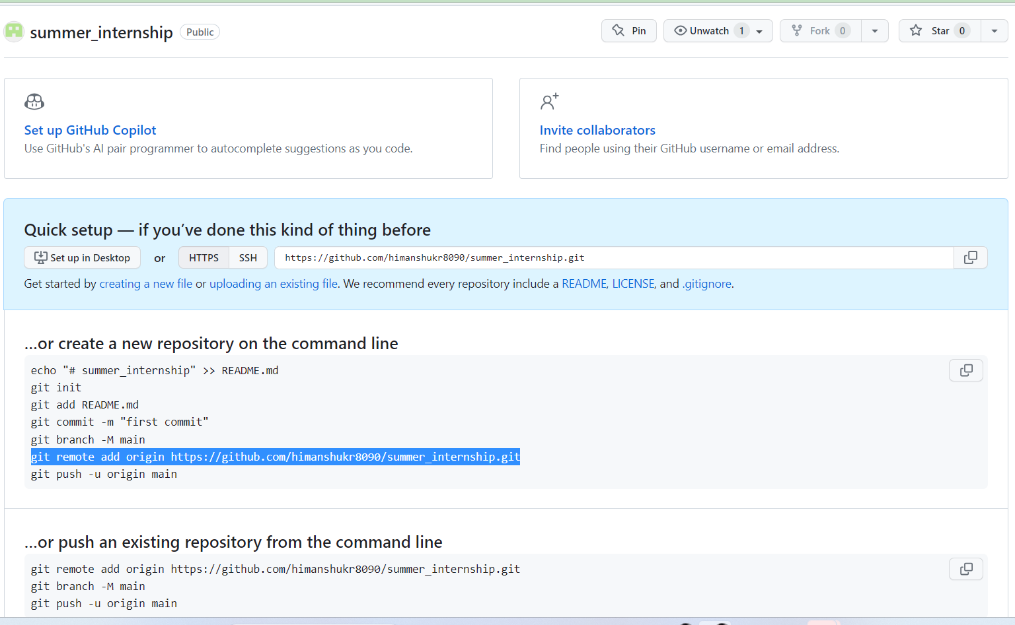
Create Repo on github :-

Slide 13
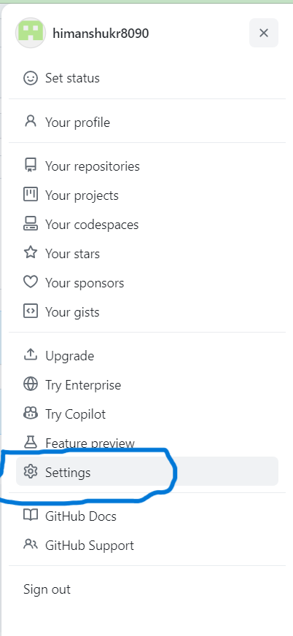
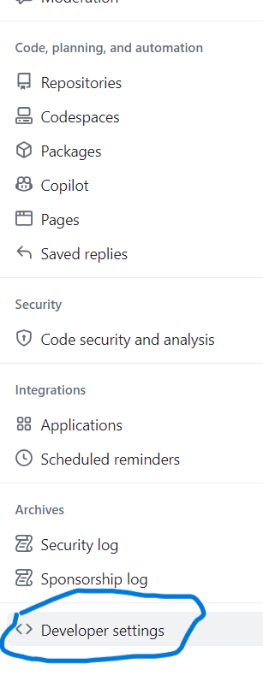
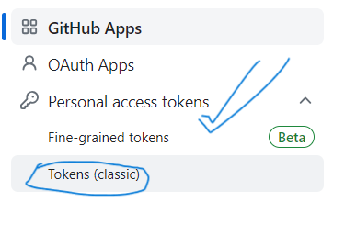
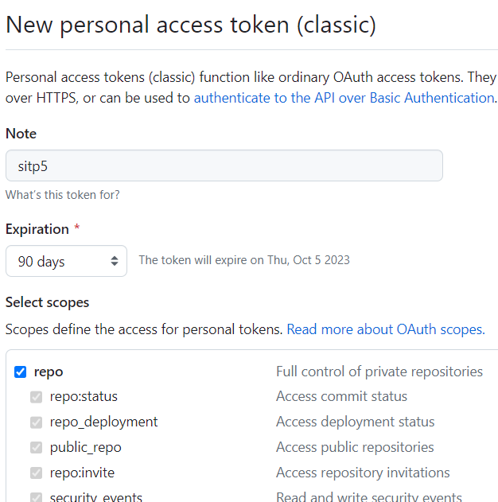

Generating PAT (Personel Access Token):-
3
2
1
4
5

Slide 14
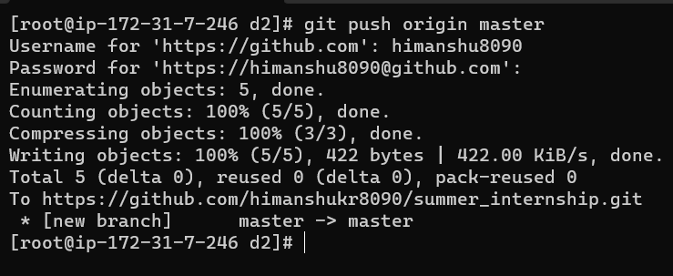
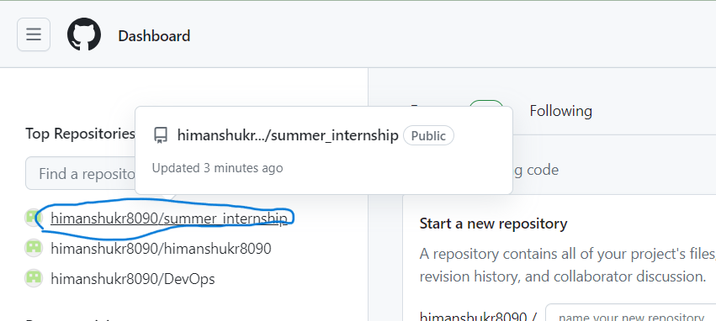
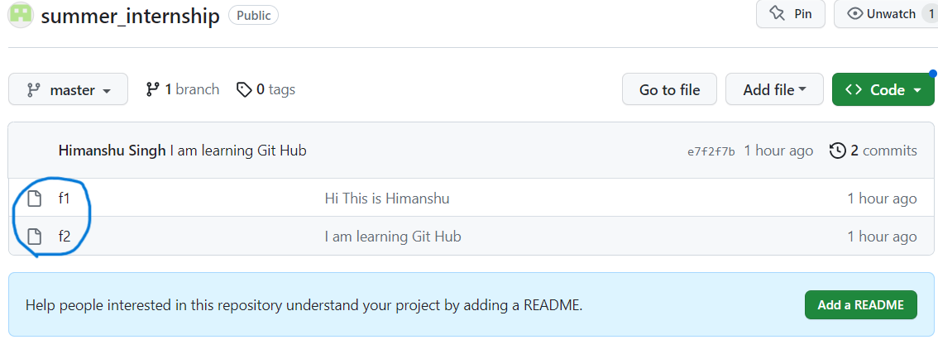
Pushing Files on GitHub :-
Two files are pused on git.

Slide 15
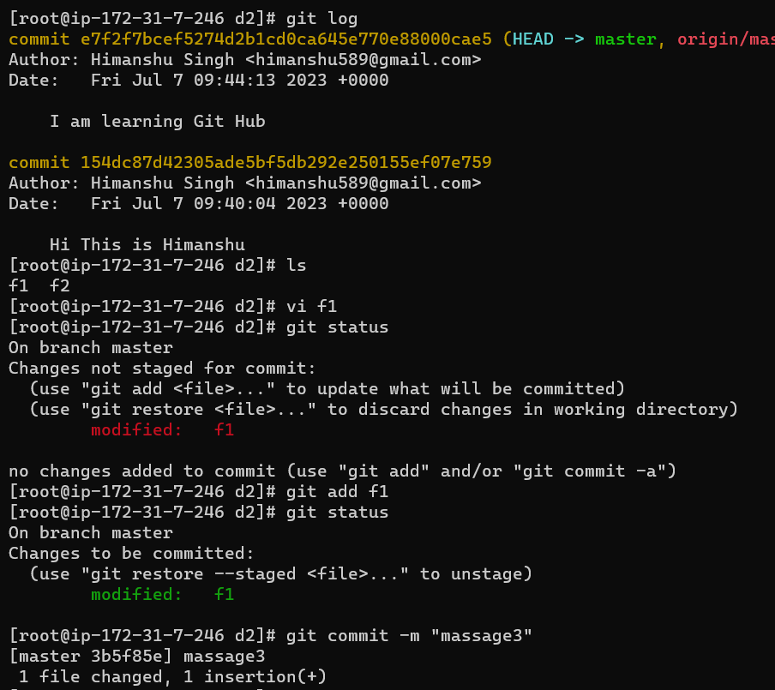
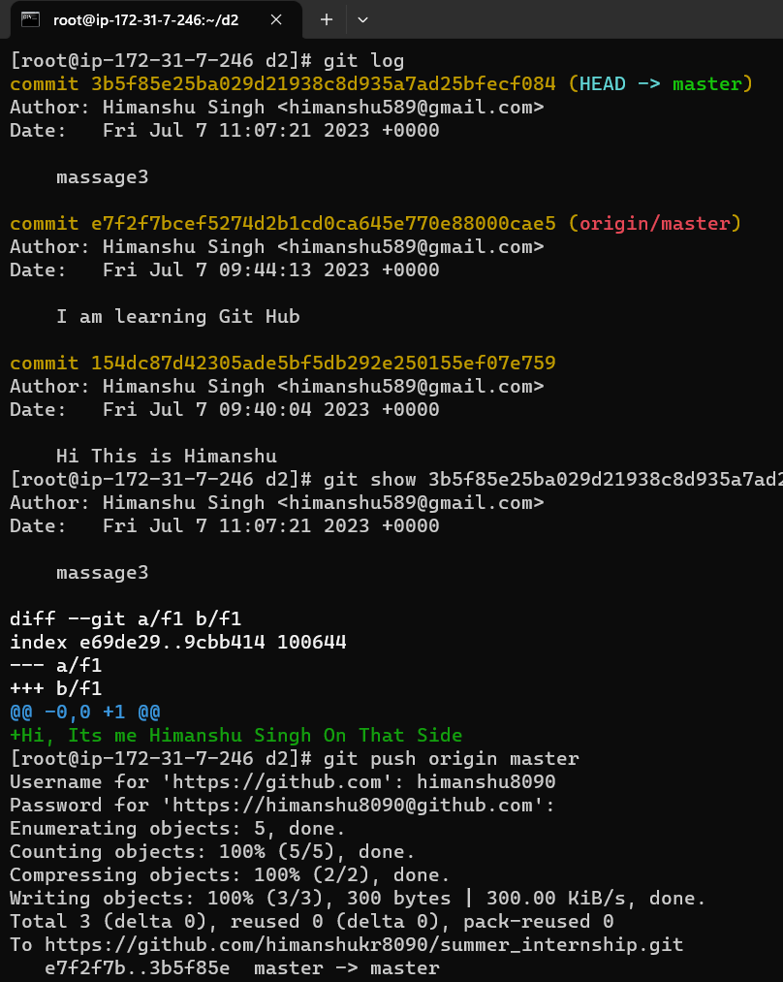
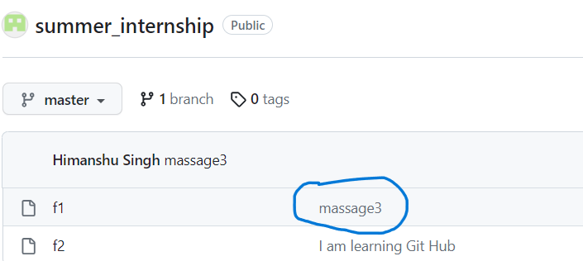
Modification in File f1 :-
Refresh Github

Slide 16
Thank You…..

